Slide 1

INSIGHTS
Who are they for?
Are they useful?
How are they defined?
Is there a better definition?

Slide 2
AGENDA
Executives need to make decisions
It is safer if they use ‘insights’
What passes for insights, from analysts, executives usually find to be of little value
Trivial, irrelevant, obvious
Maybe it’s because the definition of an ‘insight’ is not very effective
Most of what is called an ‘insight’ is really just an observation
A new conception is needed defining
AN INSIGHT

Slide 3


OUR JOB IS TO PROVIDE INSIGHTS
TO EXECUTIVES, SENIOR LEADERSHIP, ETC.

Slide 4


THEIR JOB IS TO EXECUTE
TO MAKE GOOD DECISIONS

Slide 5

QUOTES FROM
THE STRATEGIC 2015 STUDY OF
SENIOR LEADERSHIP AND DECISION MAKING
What they give me is not even relevant to my business
CEO, $4B Retailer
The results are usually too little and too late
COO, $12B Manufacturer
I get more tactics than strategy
VP STRATEGY, $2B Insurance

Slide 6

QUOTES FROM
THE STRATEGIC 2015 STUDY OF
SENIOR LEADERSHIP AND DECISION MAKING
When I question the results, the next revision has drastic changes
CMO, $22B Hotel Chain
Gives no actions,
just describes problems
CEO, $33B Entertainment Conglomerate
Most of the time I see obvious, trivial, output
CMO, $2B Casual Dining

Slide 7
WHAT ANALYSTS DEFINE AS ‘INSIGHTS’

Slide 8
Examples of ‘INSIGHTS’ from
CONSUMER INSIGHT TEAMS
92% of our customers wear some kind of jeans when they come to our store
Net revenue decreased over 3.5% YOY in same store sales
We have the highest rated product in our industry

Slide 9
Examples of ‘INSIGHTS’ from
CONSUMER INSIGHT TEAMS
Both market research and independent field tests show treatment X outperforms treatment Y
Our customers trust our brand more than all other brands
This trend is going up

Slide 10
SO What is an insight?
a checklist definition

Slide 11


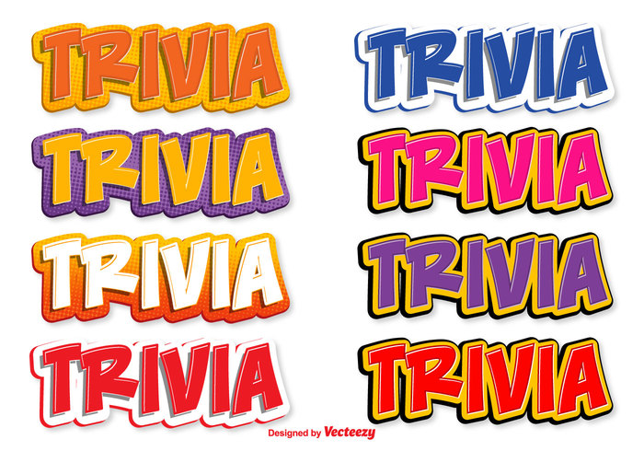
An INSIGHT
provides new, relevant, non-trivial information
Simply saying “The trend goes up” is just an observation

Slide 12


An INSIGHT
deepens understanding of consumer behavior
The purpose of marketing is to understand and incent and change consumer behavior in order to deliver a win-win transaction to both the firm and the consumer
If a strategy focuses on something other than the consumer it is probably NOT marketing
A focus on the firm or technology or products or operations or human resources or finances is probably NOT marketing
This is one of the problems w RFM: focuses on the firm not the consumer

Slide 13

An INSIGHT
quantifies causality
Must give marketers a known, measured, ‘lever’ to pull
Provides significant variables and has confidence in the direction
Analytics is about THIS causes THAT
Insights are usually PREDICTIVE, not DESCRIPTIVE
CAUSALITY…

Slide 14
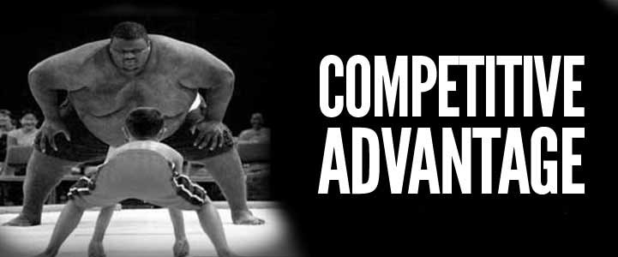
An INSIGHT
delivers
a competitive advantage
Must provide a better strategic position
Must be worthwhile to do in competitive terms

Slide 15

An INSIGHT
provides a
financial return
Must calculate ROI, contribution margin, risk, cost of being wrong
Must increase revenue, or increase satisfaction, or decrease expenses
Financial Return

Slide 16
AN INSIGHT
ACTION-ABILITY
Delivers new, relevant information
Increases understanding of consumer behavior
Drives a financial return
Quantifies causality
Provides a competitive advantage
DRIVES ACTIONS

Slide 17
ACTIONABILITY
quantity = f(consumer confidence, corporate tax rate, seasonality, age, education, income)
What insights—actionability—does the above model give marketers?

Slide 18
INSIGHTS
CHATTERBOX segment YOY revenue increased by 6.7%
Primary drivers were:
targeted discount optimization (~3.4%)
aligning more EM and less DM communications (~1.5%)
faster trigger campaigns (~0.9%) and
brand messages (~0.7%)
sooooo KEEP DOING IT!
SILVER SNEAKERS campaign test outperformed control by 1200 members (4.1%)
Each member:
tends to live 8.7 years longer
tends to remain our customer 4.8 years longer and
brings > incremental $405 annual premiums
sooooo LET’S PRODUCTIZE THIS!

Slide 19
Notes For An Analytic Presentation
Think like the client
Two sources of all business emotions: fear and greed
Econometric / model building flowchart
The point of analytics is to decrease the probability of marketers making a mistake
How perfect do the analytics have to be in order to act upon?
Insights without strategy is like a science fiction movie without a plot.
How to Do an Analytic Project: Tell a Story
Beginning, middle and end
Set up the problem—why do we care?
Go through the process / explain why and how
What are the conclusions / how it can be used / implemented

Slide 20
Life Expectancy & Retention: Key Factors
Non-Complex Chronics
30%
Life Expectancy
Retention
Decreases
Increases
Decreases
Increases
Average Age = 77.6 years
Average Tenure = 57.4 months
Behavioral Impacts
Fixed & Conditional Impacts
IHWA Completion is the strongest additive factor, both for Life and Retention
Med Adherence and Preventive Screenings round up the top-3 positive factors
The compound effect of IHWA Completion and Clinical Participation doesn’t seem to add to Life (than IHWA alone) but adds +1 yr to Tenure
RightSource Use has a positive impact on Retention
High Calls-to-Claims Ratio and % of Rejected Claims (most likely associated with higher ER/IP events) are a strong leading indicator of churn
High incidence of Urgent Care visits could also be a precursor of churn due either to a more price-sensitive consumer or a weaker relationship with a PCP
Silver Sneakers Participation has a small, positive impact on Retention
Need refinement of Disabled as the largest negative factor to Life (note: virtually all Disabled members enrolled with a pre-existing disability before 65 yrs old)
Higher CMS Risk CHF members show incrementally positive outcomes
Comorbidities reduce Life Expectancy but also, due to more complications, members tend to be more ‘anchored’ to Humana and the care they receive
HMOs show a higher positive impact on Life
While the # of IP Admits negatively impacts both Life (severity of issues) and Retention (member cost driver?), the # of ER Events has a positive impact on Life (quicker diagnosis?) but negative on Retention (member cost driver?)

Slide 21
Individual-Member: LTV-Application Example
Illustrating the increase in estimated LTV profitability for being Med-Adherent/Compliant
2014 – 2016 Net Present Value (NPV)
Med-Adherent = NO
Med-Adherent = YES
Life Expectancy
Life Expectancy
77.5 yrs
80 yrs
Estimated Retention
Estimated Retention
52.5 mos
64.3 mos
3-yr NPV
3-yr NPV
- $656
$1,816
LTV profitability increases through Med-Adherence’s positive impact on Life Expectancy (+2.5 yrs), Retention (+11.8 mos), and reduction in Medical Costs (-$79/mo)

